Slide 1



ONLINE RETAIL Customer Segmentation & Cohort Analysis
SDA1071 - Mashael
SDA1086 - Yousef
SDA1075 - Abdulaziz
SDA1064 - rahaf
SDA1078 - raseel
SDA1065 - Aseel
SDA1068 - Zahra
SDA1077 - Reem
SDA1084-Nawaf
SDA1093 - Maitha

Slide 2

Introduction
This project leverages the Online Retail dataset from the UCI Machine Learning Repository to perform a comprehensive analysis encompassing exploratory data exploration, customer segmentation, RFM (Recency, Frequency, Monetary) analysis, clustering, and cohort analysis.

Slide 3
01
02
03
Exploratory Data Analysis (EDA)
Distribution Analysis
RFM Analysis
TABLE OF TASKS
04
05
06
Customer Segmentation
Clustering
Cohort Analysis

Slide 4

01
Exploratory Data Analysis (EDA)

Slide 5
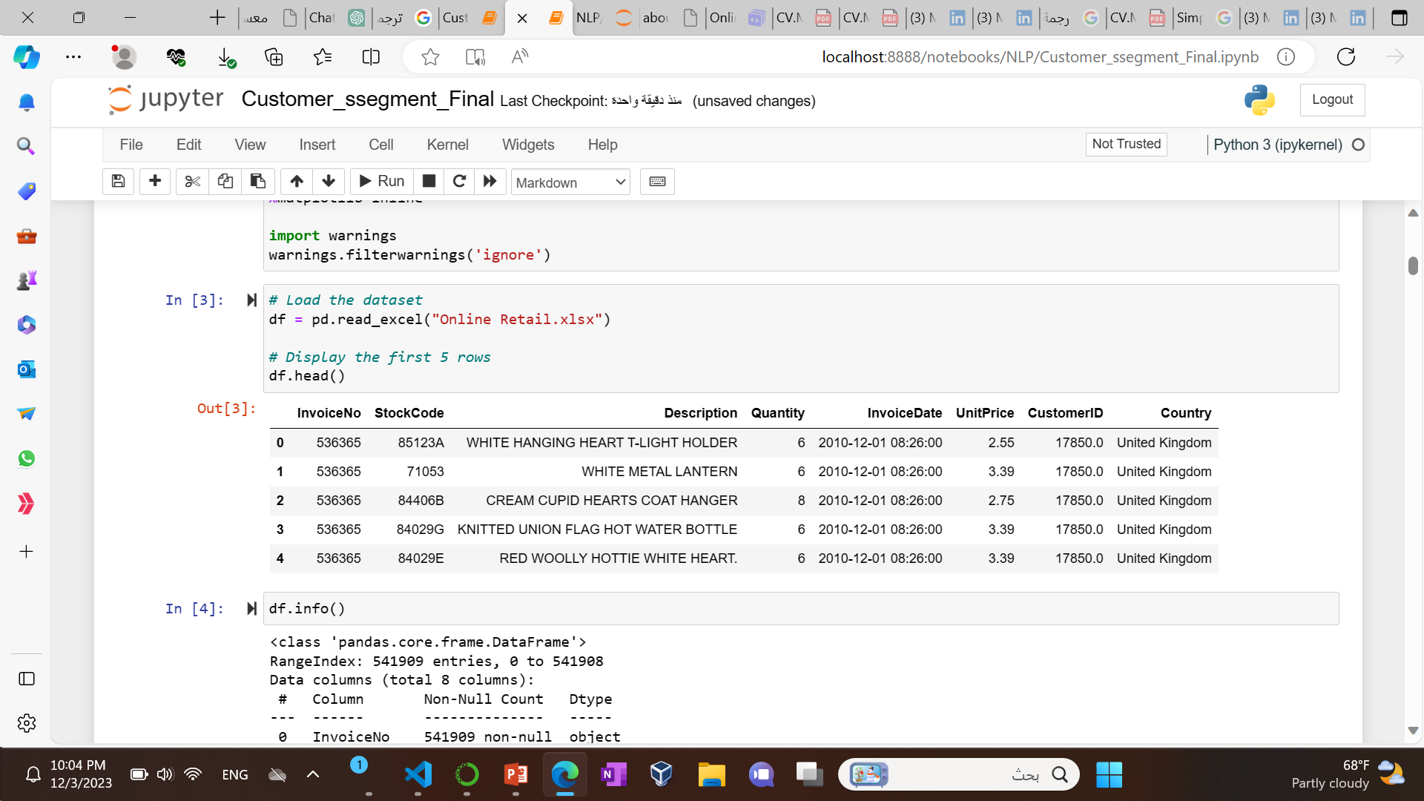
overview of the structure and content of the DataFrame.

Slide 6
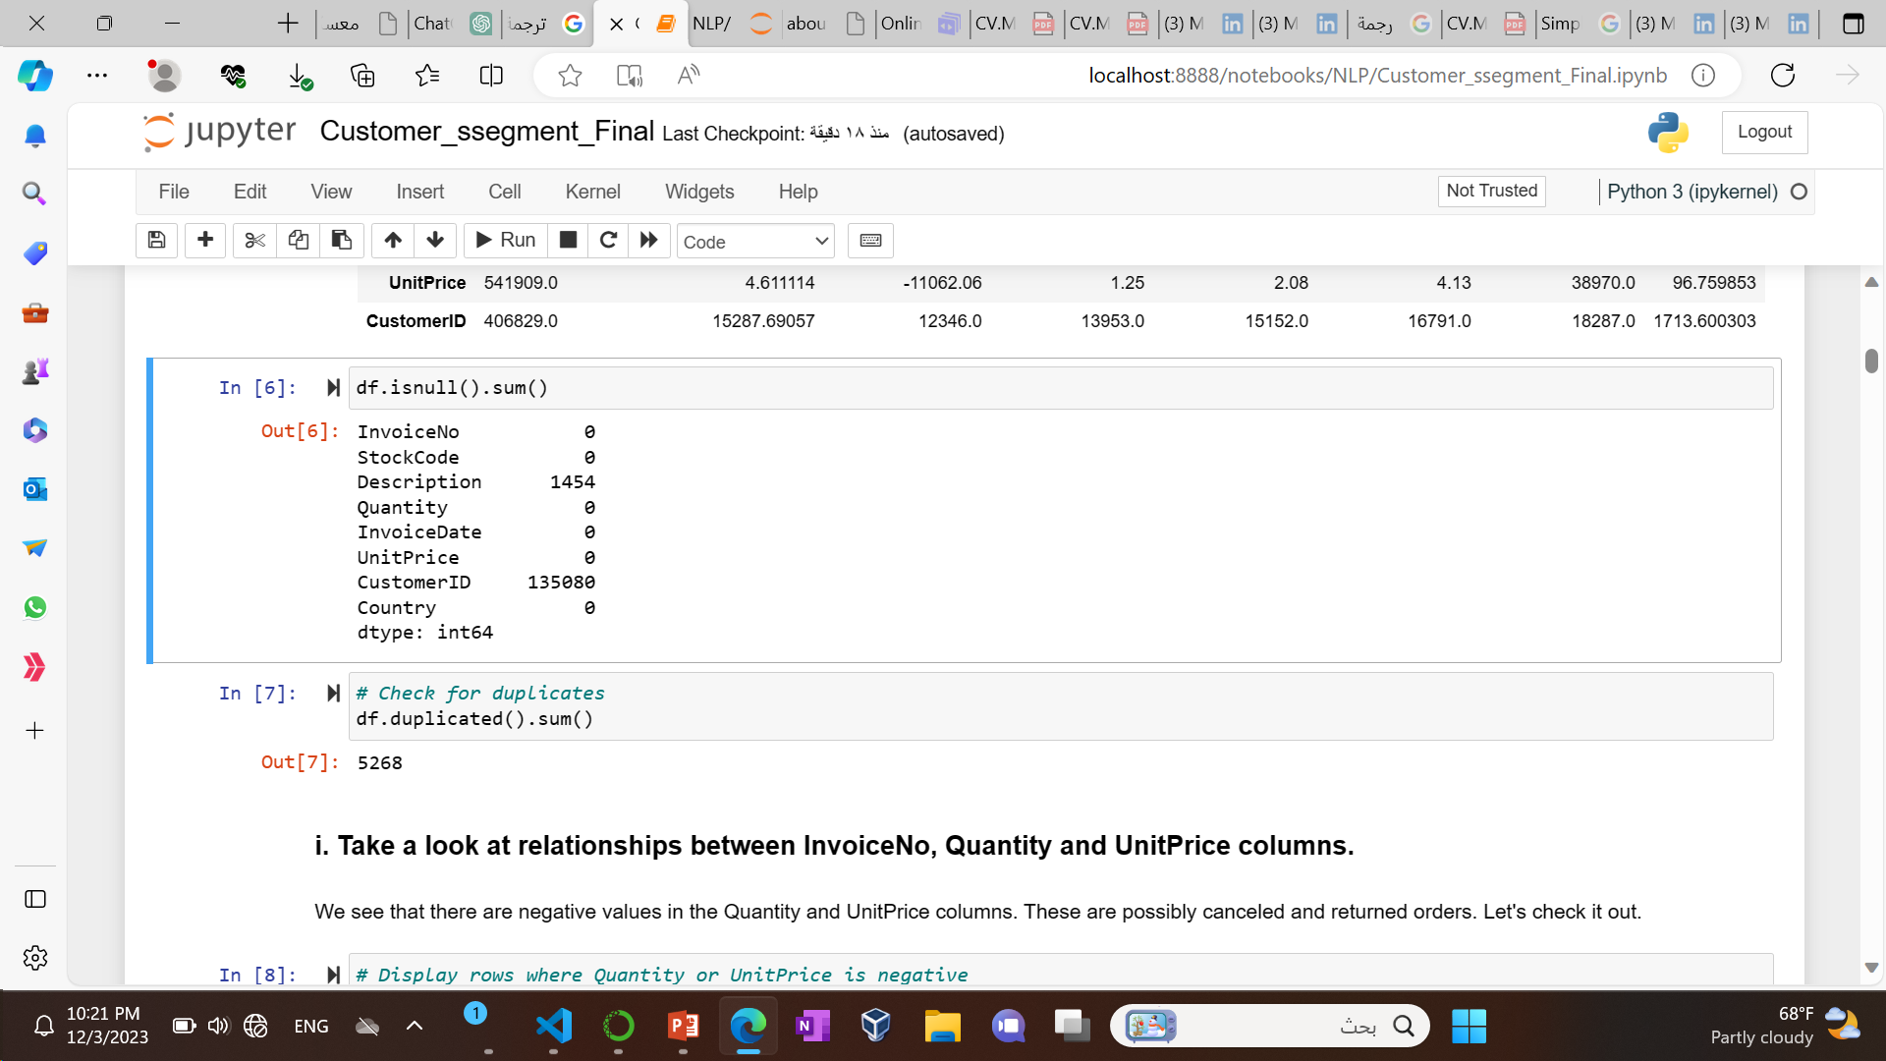
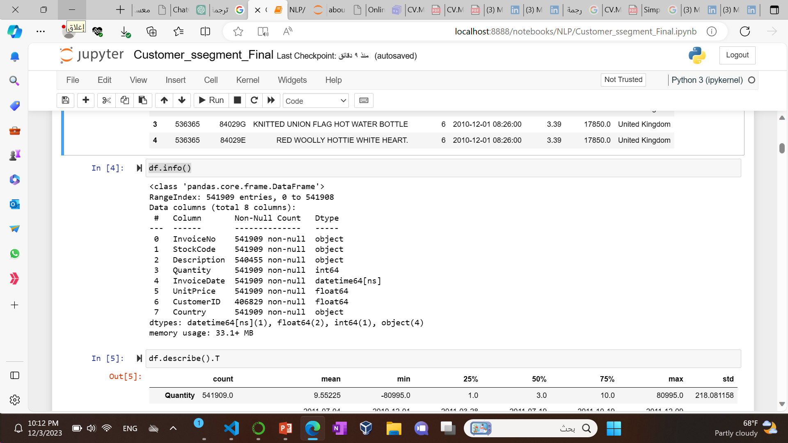
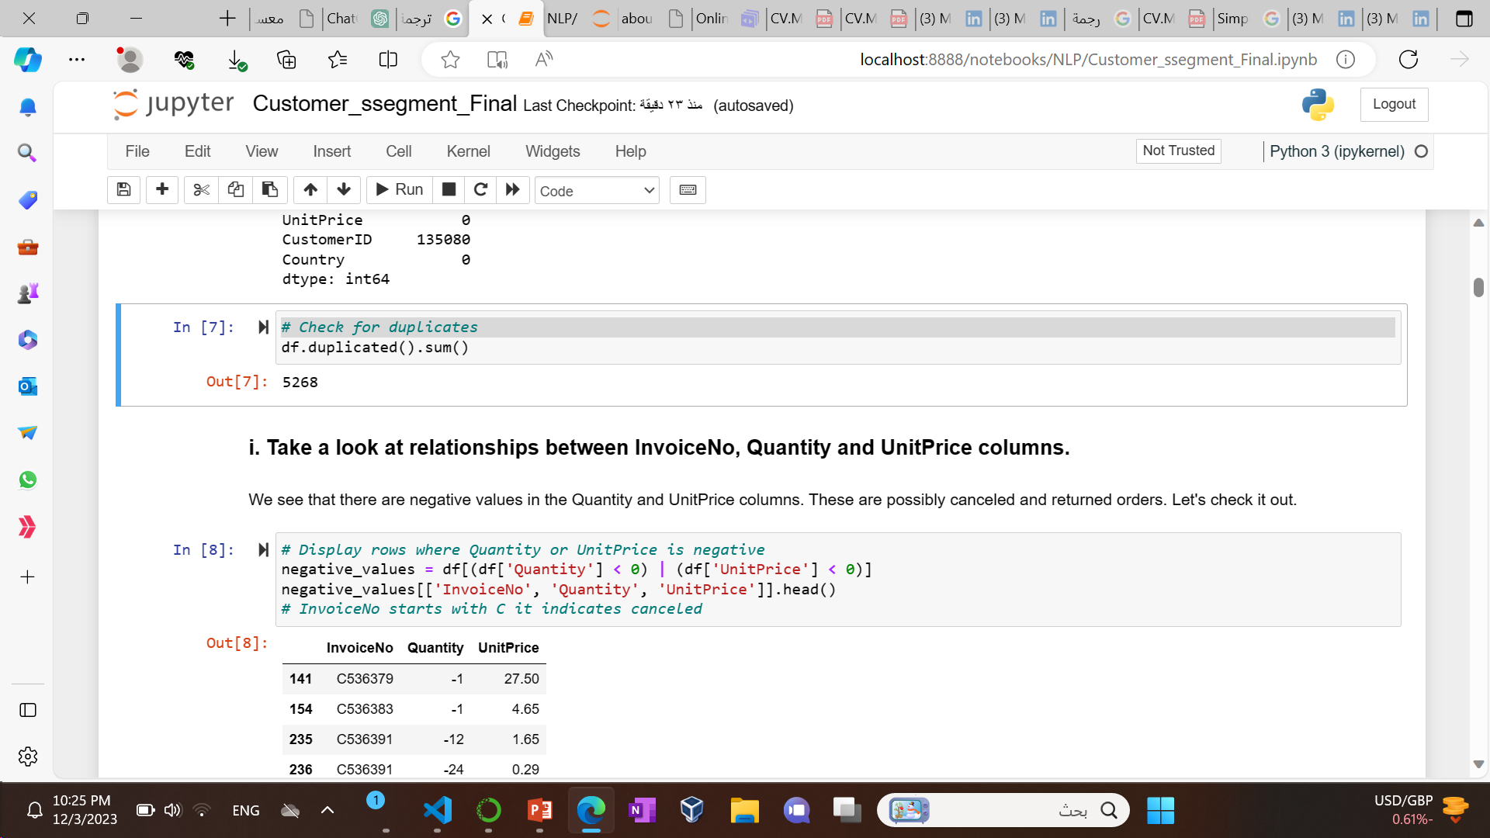
summary of the DataFrame.

Slide 7
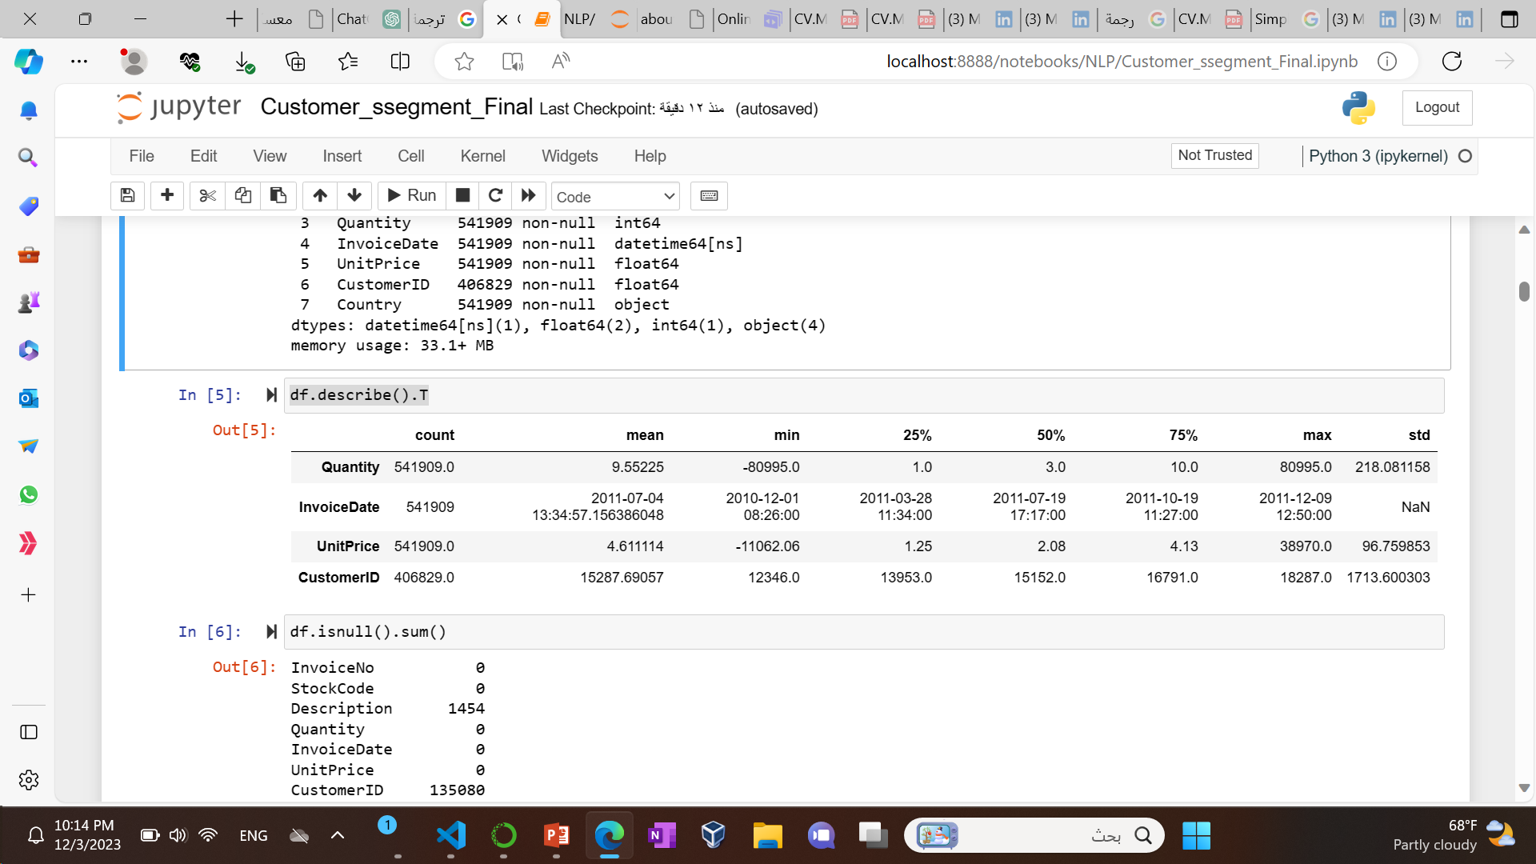
overview of key measures such as mean, standard deviation, minimum, 25th percentile, median, 75th percentile, and maximum for each numerical feature in the dataset.

Slide 8
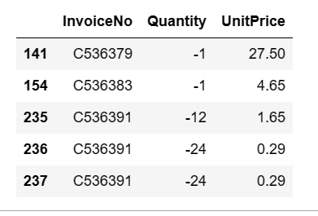
We see that there are negative values
InvoiceNo starts with C it indicates canceled
And number of canceled orders in the dataset, which is 3836.

Slide 9
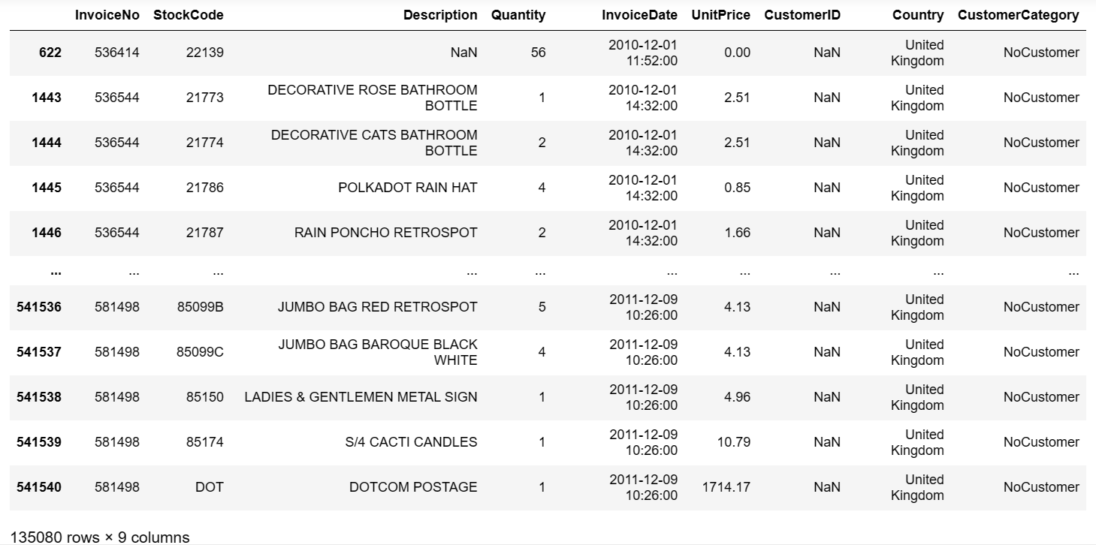
Handling Missing Values lets Display rows where CustomerCategory is 'NoCustomer'

Slide 10
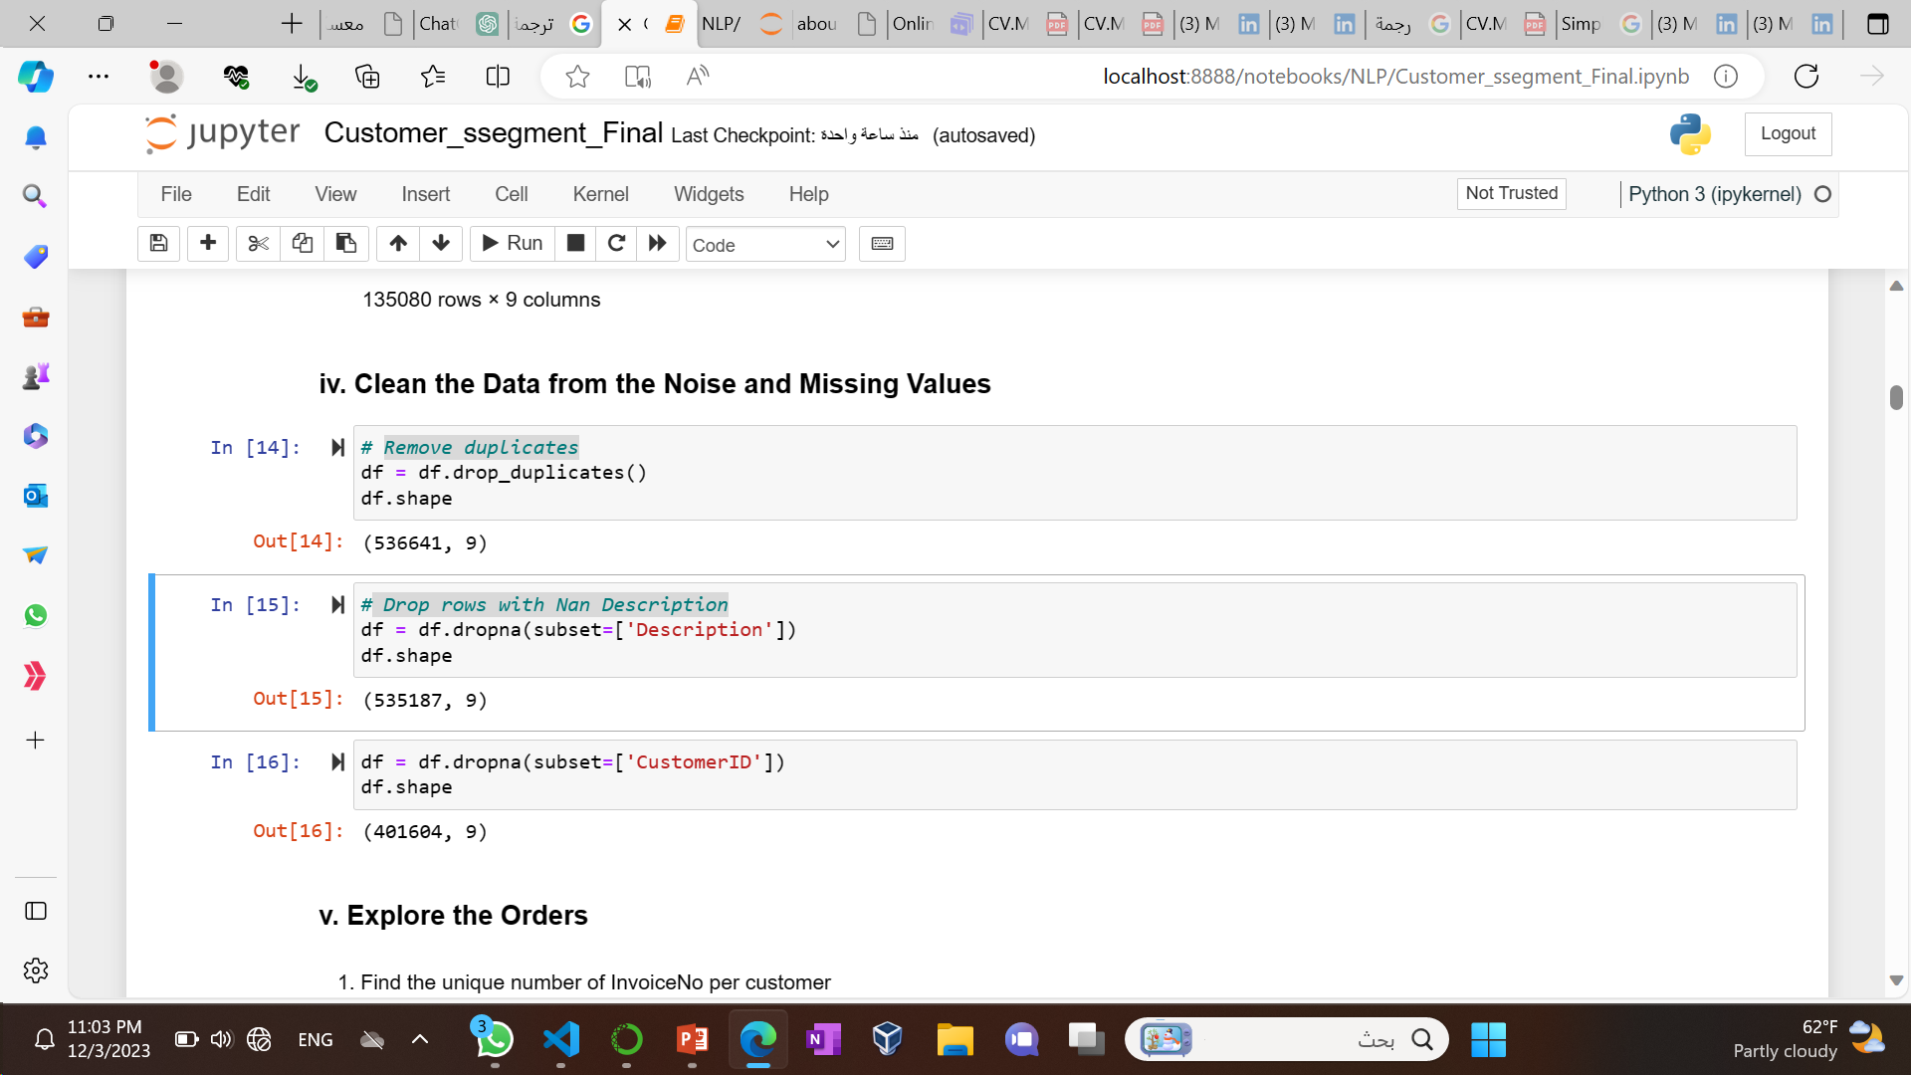
Clean the Data from the Noise and Missing Values
Remove duplicates
Drop rows with Nan Description
And NanCustomerID

Slide 11
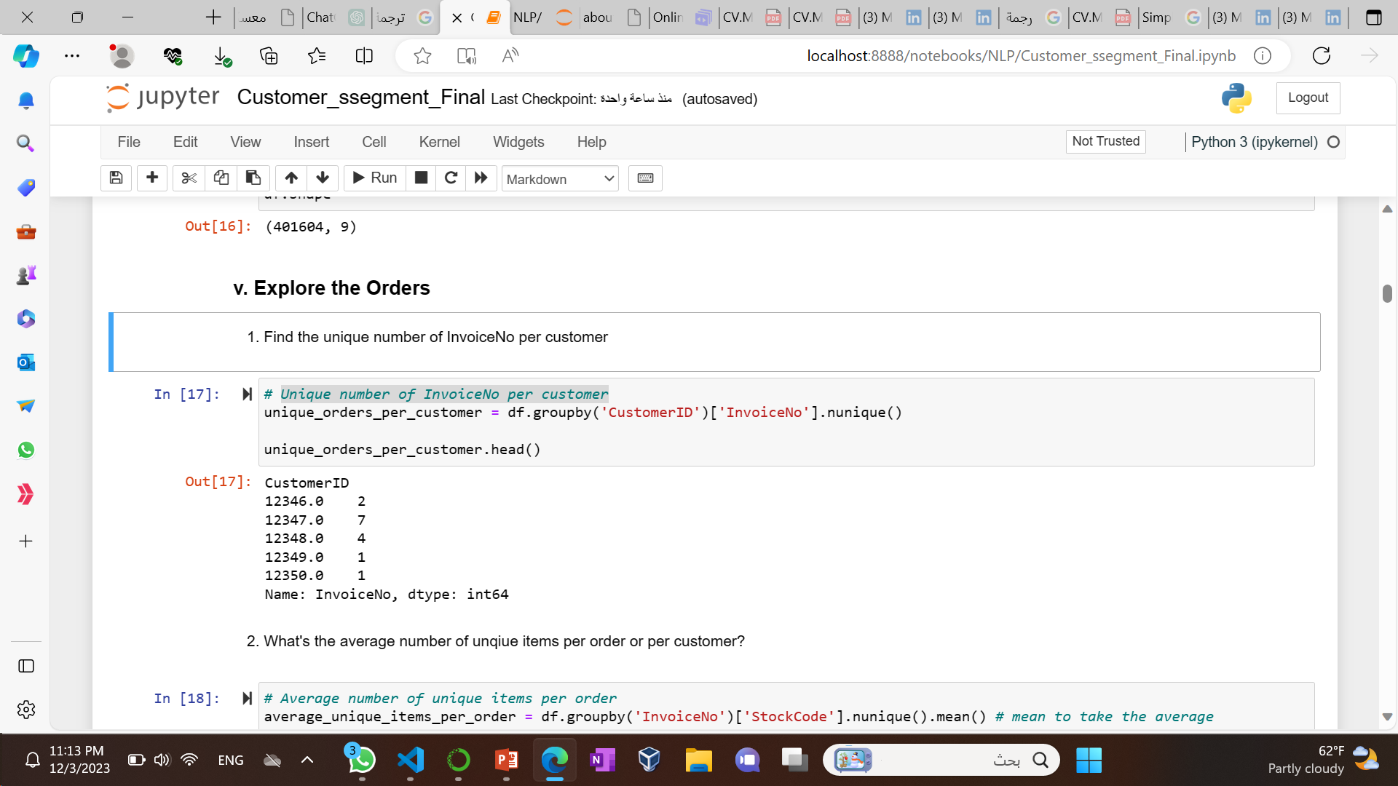
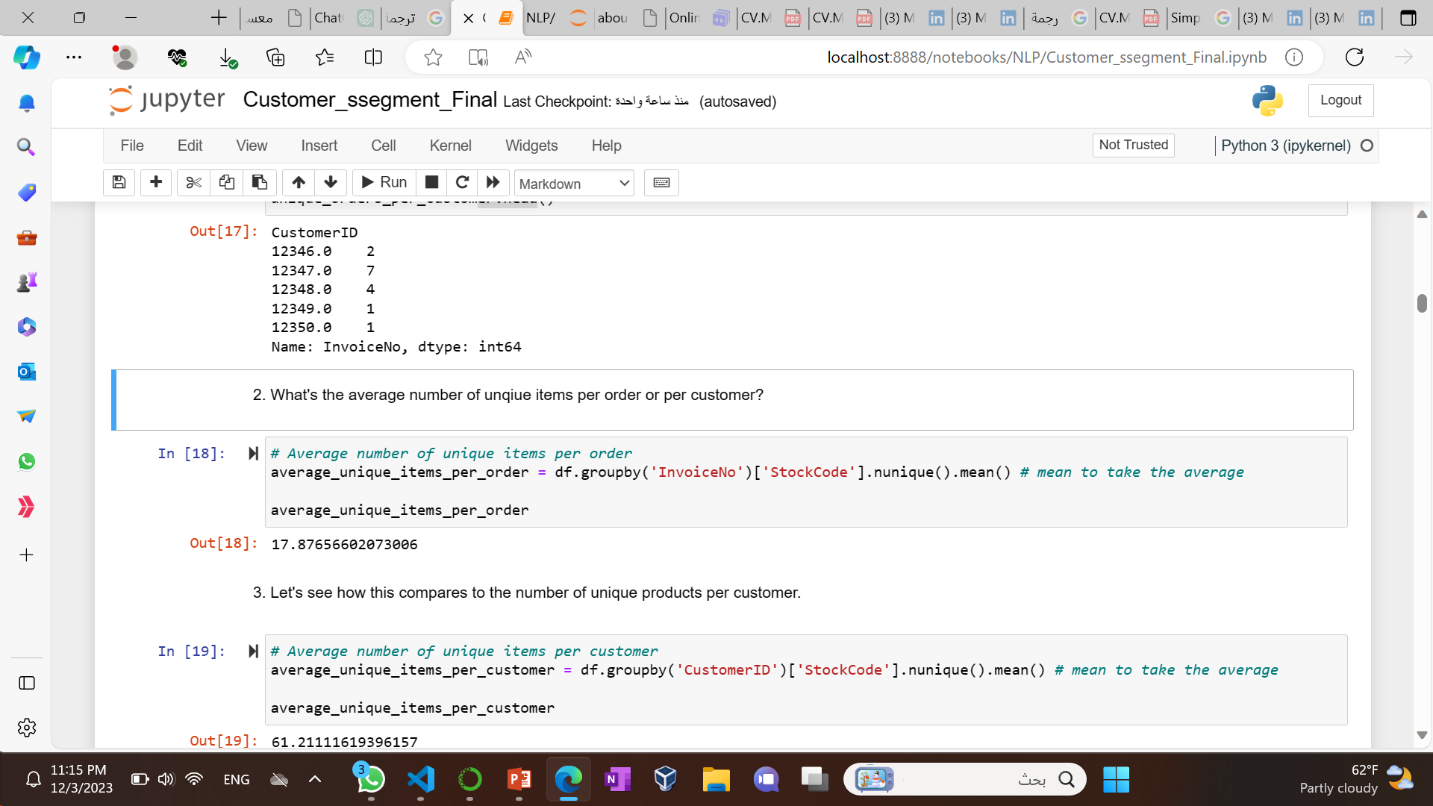
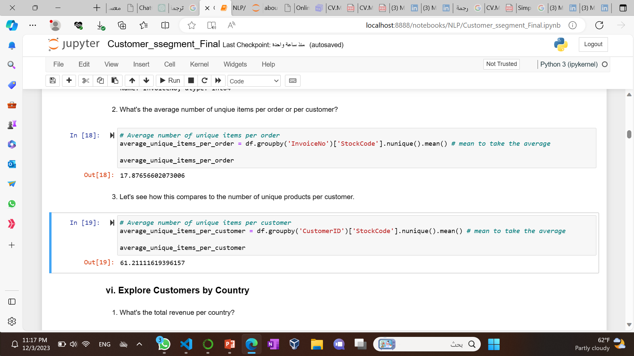
Explore the Orders
Unique number of InvoiceNo per customer
the average number of unqiue items per order
the average number of unique products per customer.

Slide 12
01
Exploratory Data Analysis (EDA)
Investigate data structure, identify missing values, and employ data visualization techniques.
Conduct descriptive analysis to understand feature relationships and address data noise and missing values.

Slide 13
02
Distribution Analysis

Slide 14
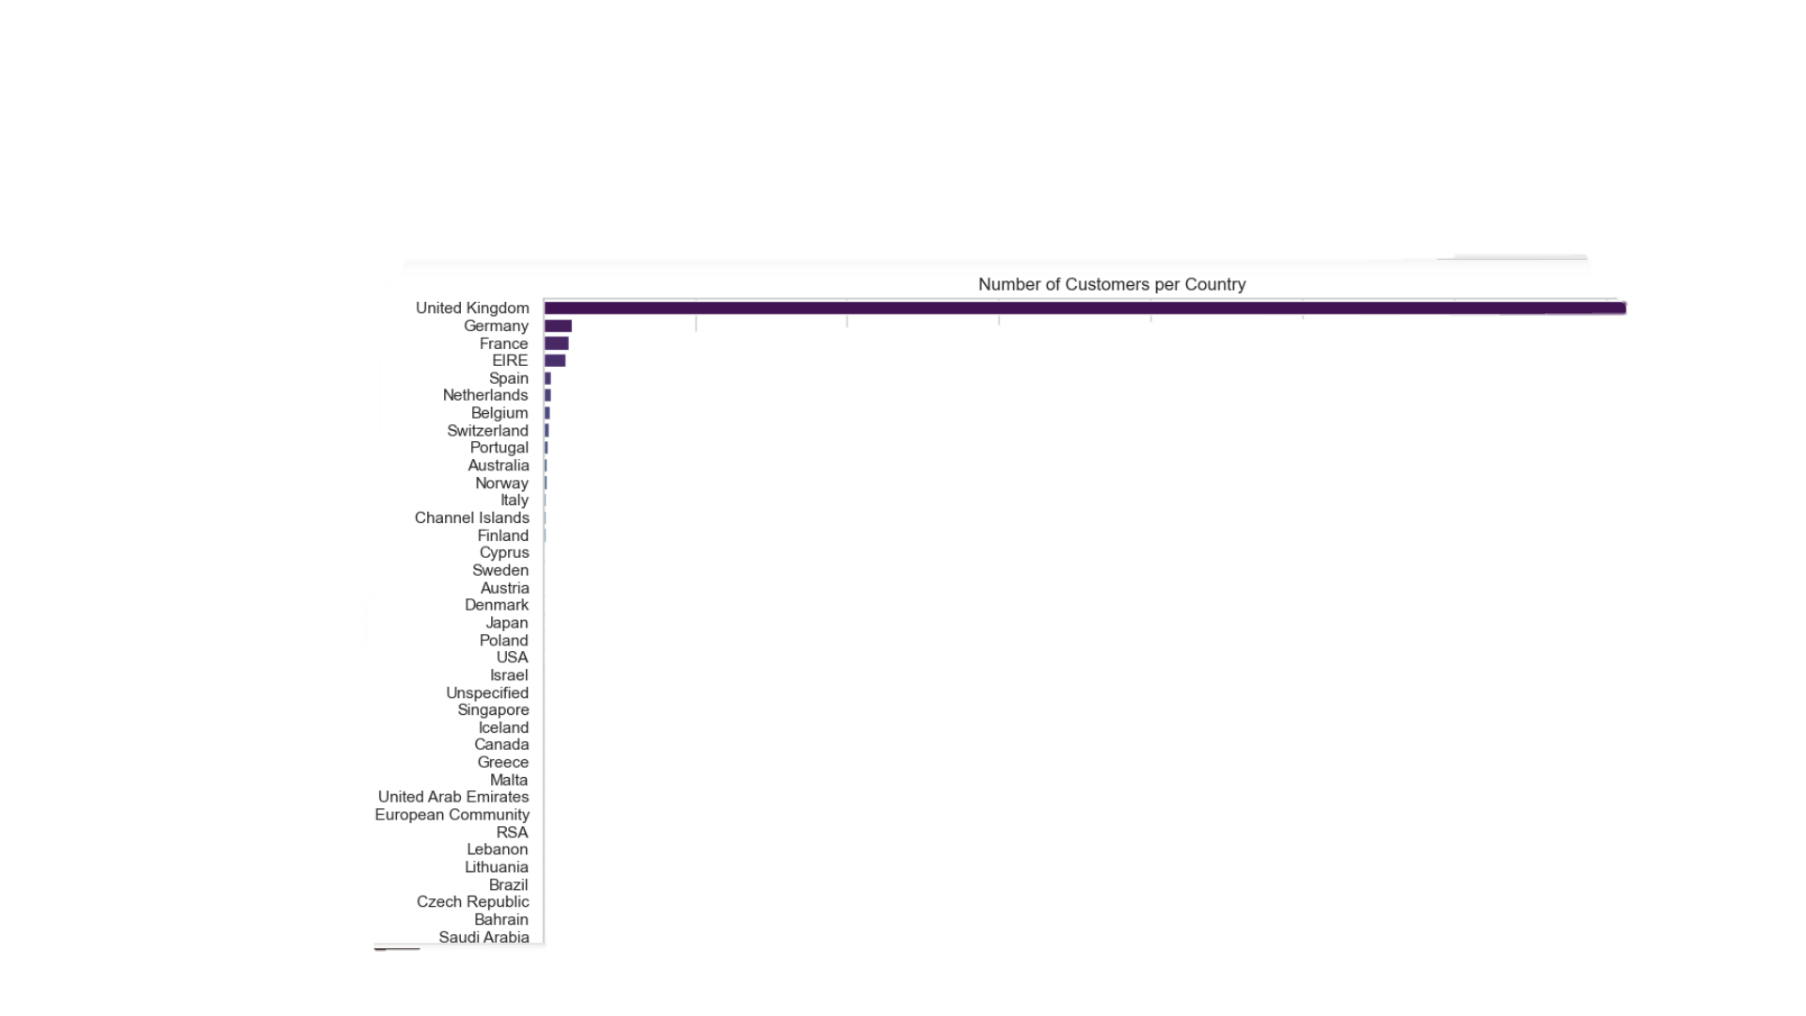
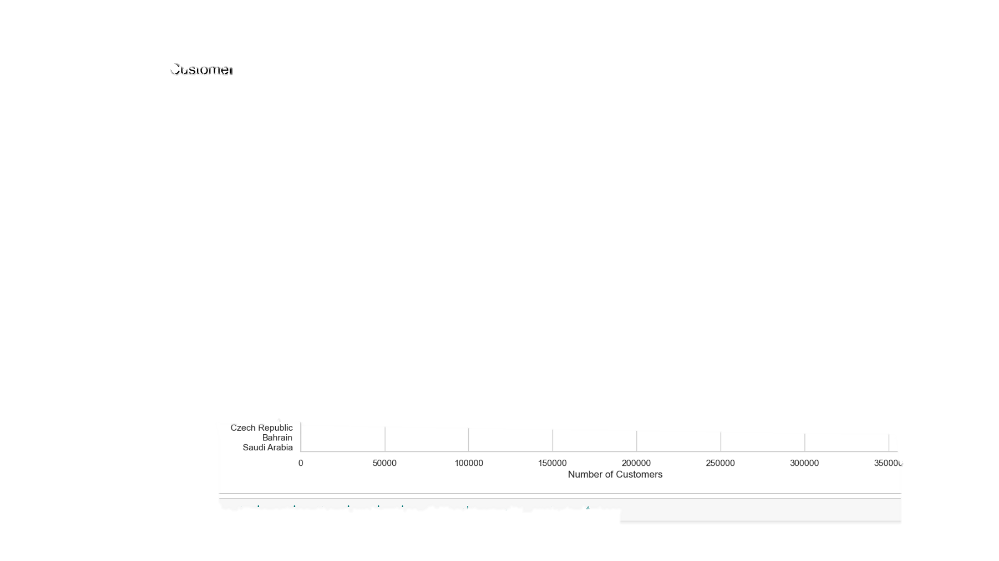
Explore Customers by Country

Slide 15
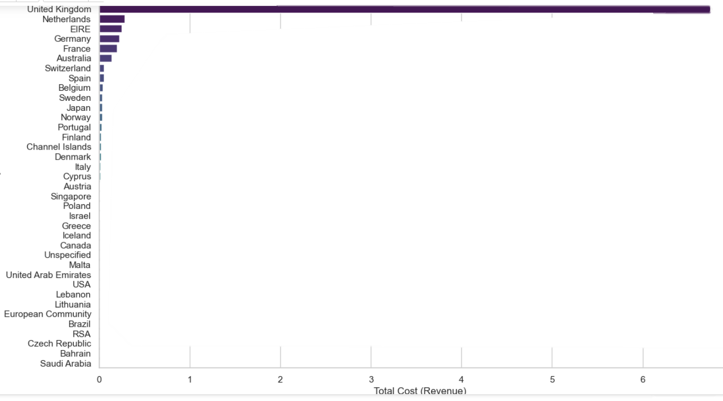
Explore Customers by Country

Slide 16

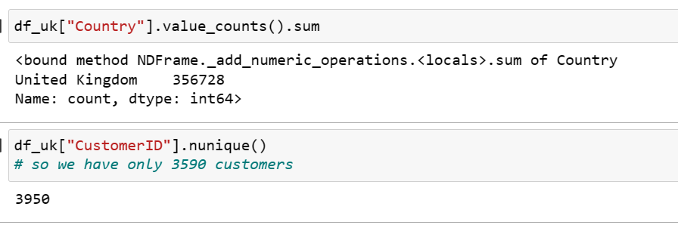
UK is the most sales
The UK not only has the most sales revenue, but also the most customers. Since the majority of this data set contains orders from the UK, we can explore the UK market further by finding out what products the customers buy together and any other buying behaviors to improve our sales and targeting strategy.
So we will Create df_uk DataFrame for the UK market

Slide 17
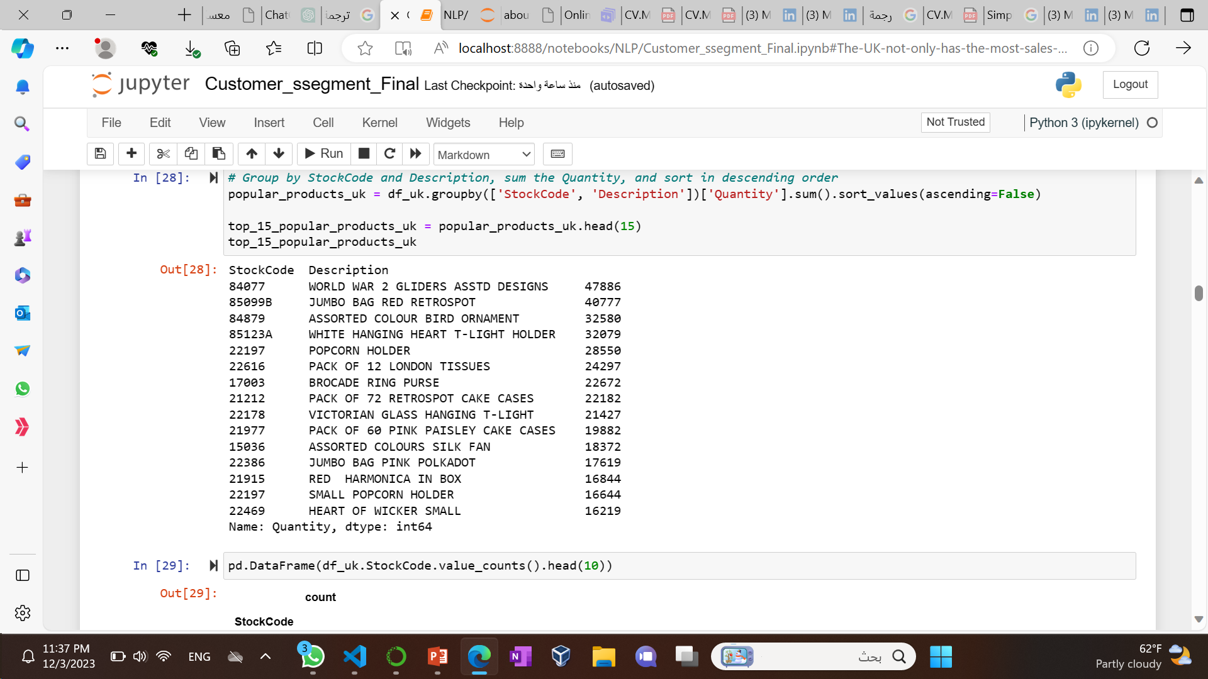
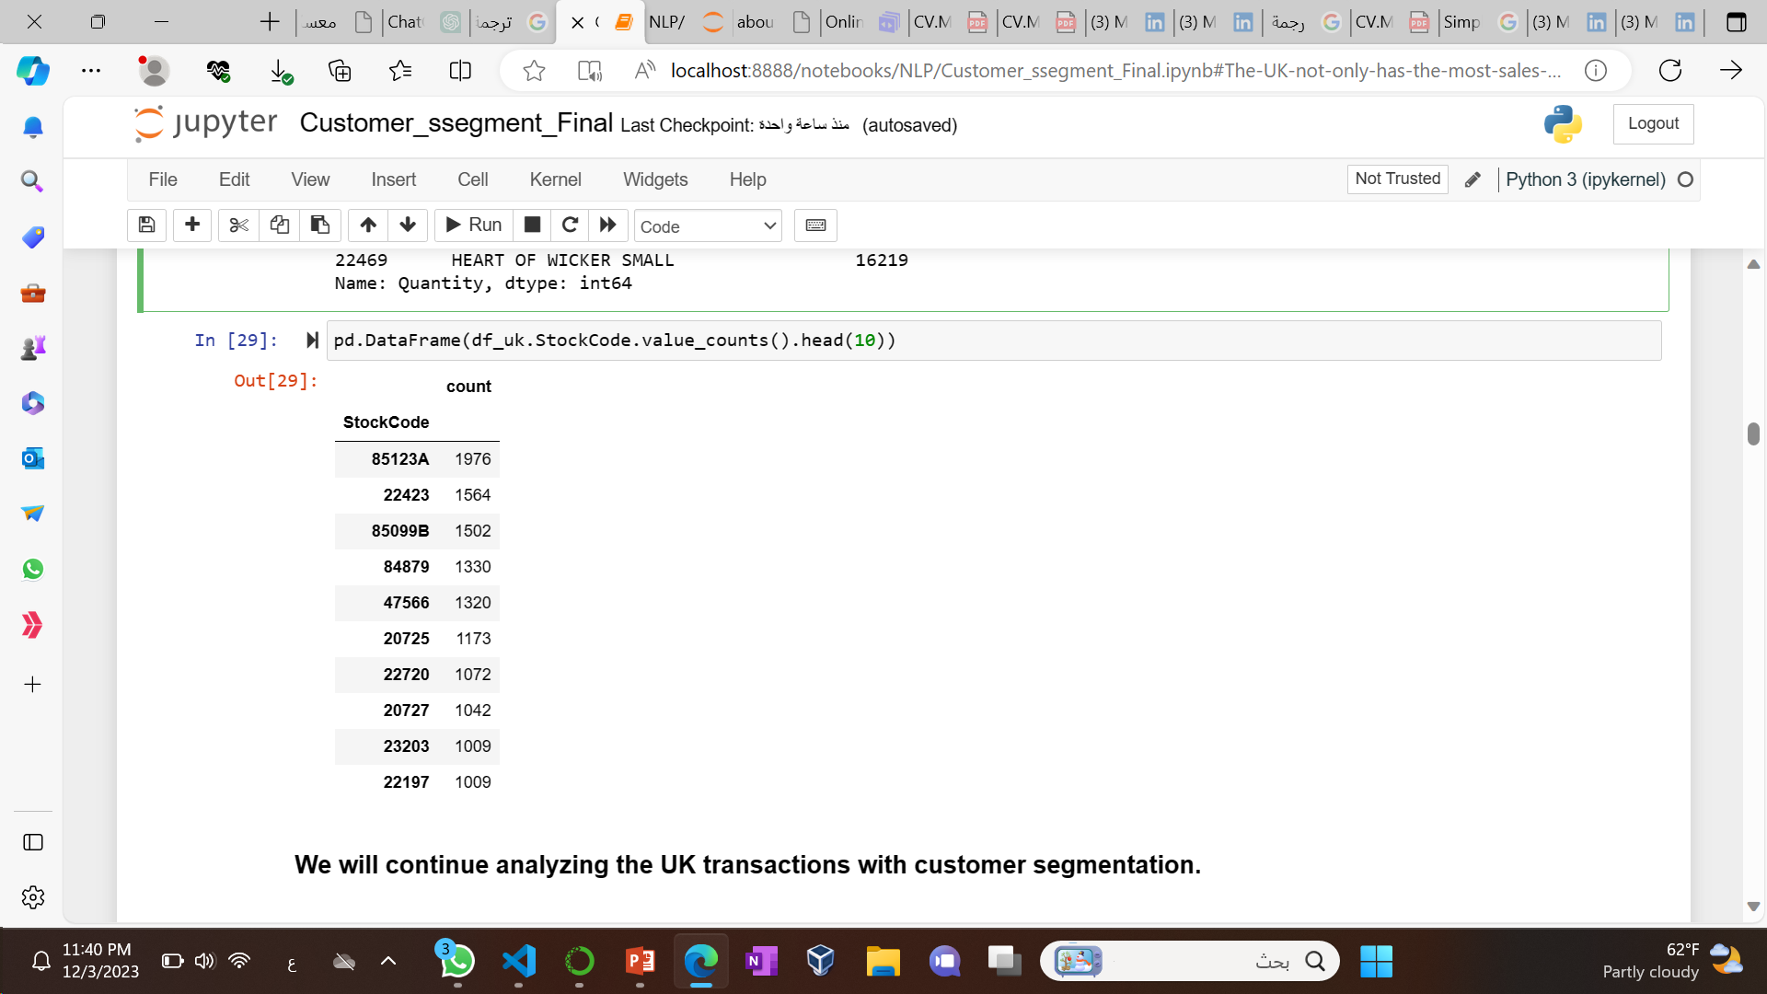
popular products in the UK
Group by StockCode and Description, sum the Quantity
number of times each product has been sold

Slide 18
02
Distribution Analysis
Examine the distribution of orders, customers, and countries to inform sales policies and resource allocation.
Observe that the UK dominates both sales revenue and customer count, leading to a focus on UK transactions for subsequent analyses.

Slide 19
03
RFM Analysis
We will start with RFM Analysis
RECENCY (R): Time since last purchase
FREQUENCY (F): Total number of purchases
MONETARY VALUE (M): Total monetary value
Benefits of RFM Analysis
Increased customer retention
Increased response rate
Increased conversion rate
Increased revenue

Slide 20
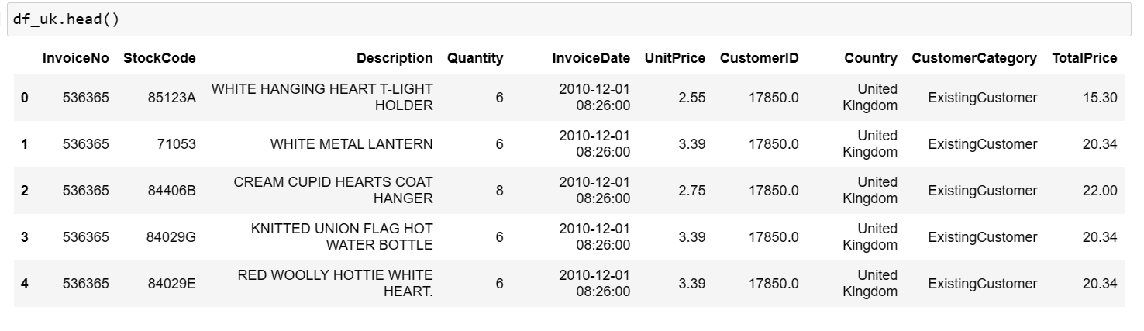
Review df_uk DataFrame

Slide 21
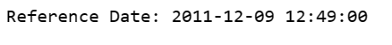
STEP to calculate the recency values
Convert the 'InvoiceDate' column to datetime format
Group by 'CustomerID' and find the last purchase date
Choose a date as a point of reference
use the maximum date in the dataset

Slide 22
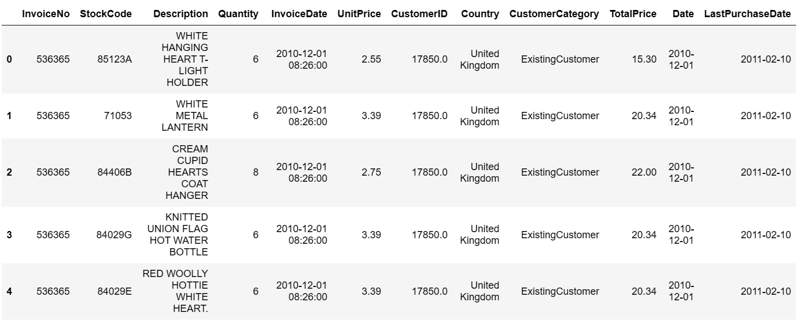
merging the df_uk with the last_purchase_date

Slide 23
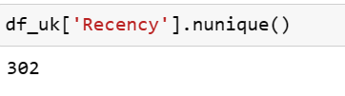
STEP to calculate the recency values
Calculate the days since last purchase
Finally drop Last_Purchase_Date since we don't need it anymore

Slide 24
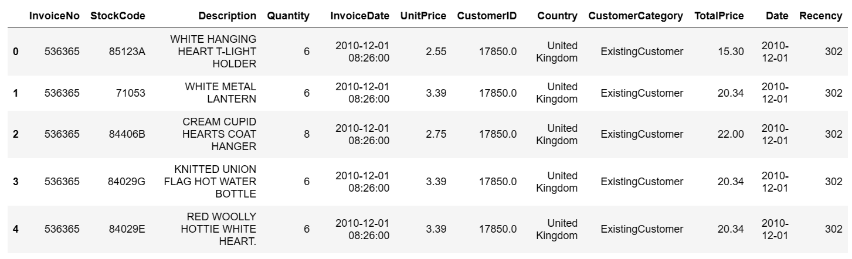
df_uk with the recency

Slide 25
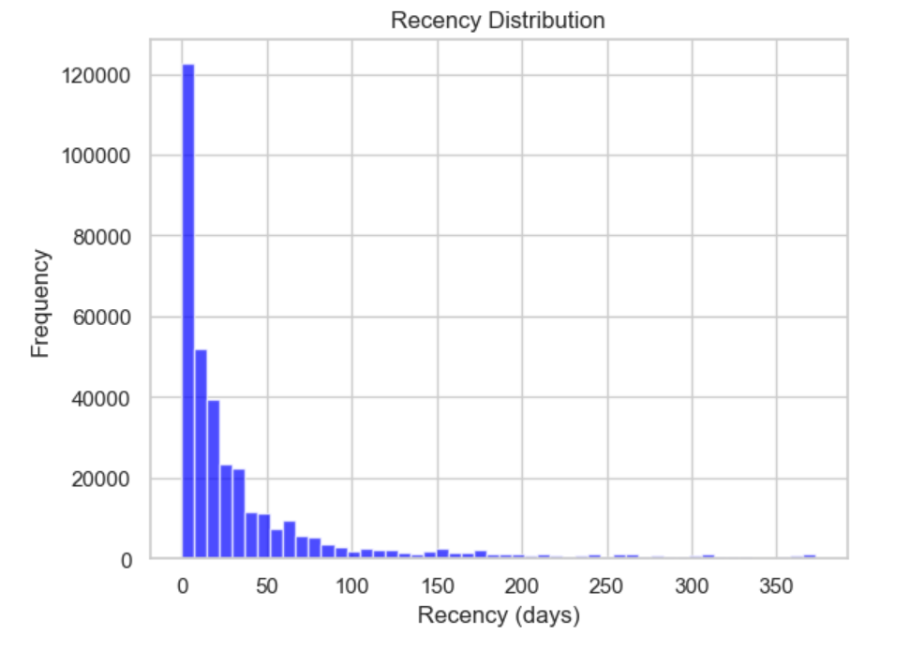
Plot RFM distributions

Slide 26
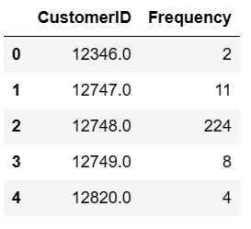
STEP to calculate Frequency Number of purchases
Calculate the frequency of purchases
Make a copy of df_uk and drop duplicates

Slide 27
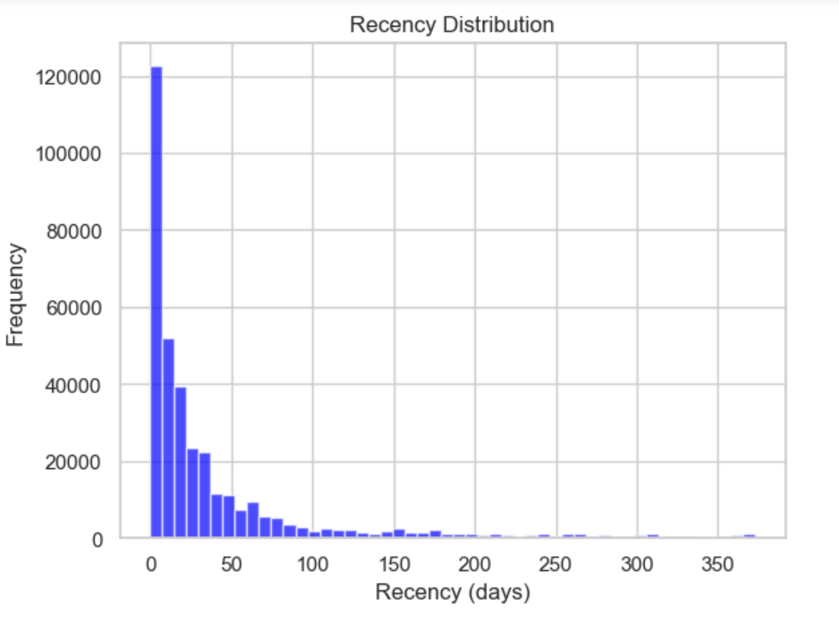
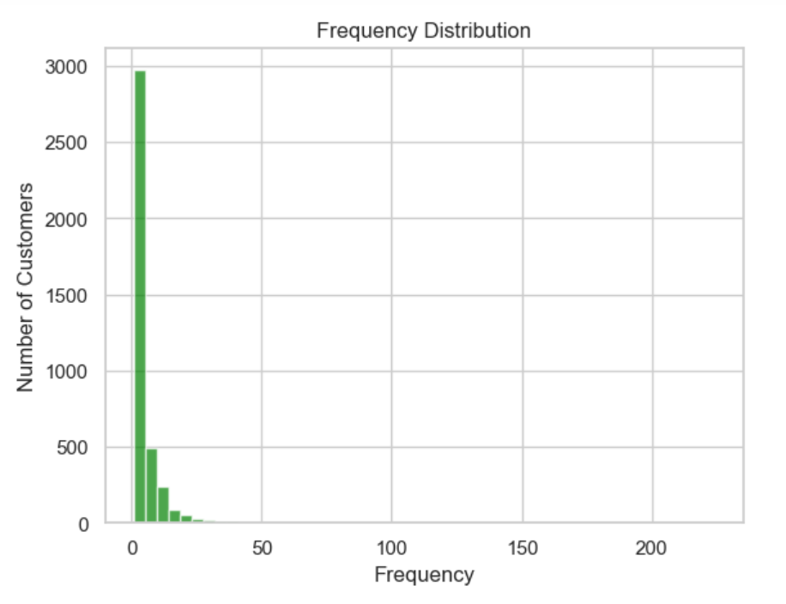
Plot RFM distributions

Slide 28
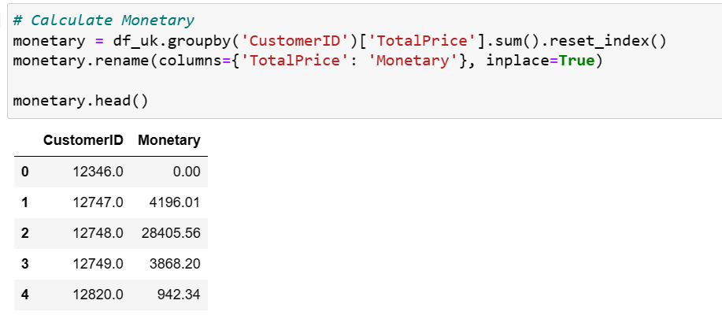
Total amount of money spent
Calculate sum total cost by customers and named "Monetary"

Slide 29
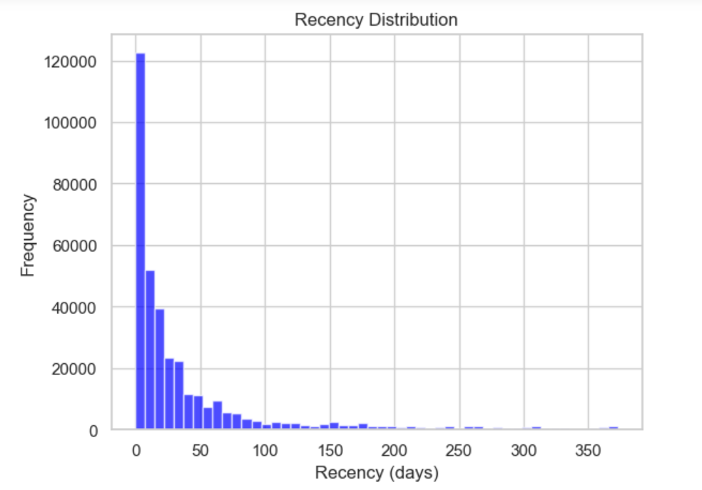
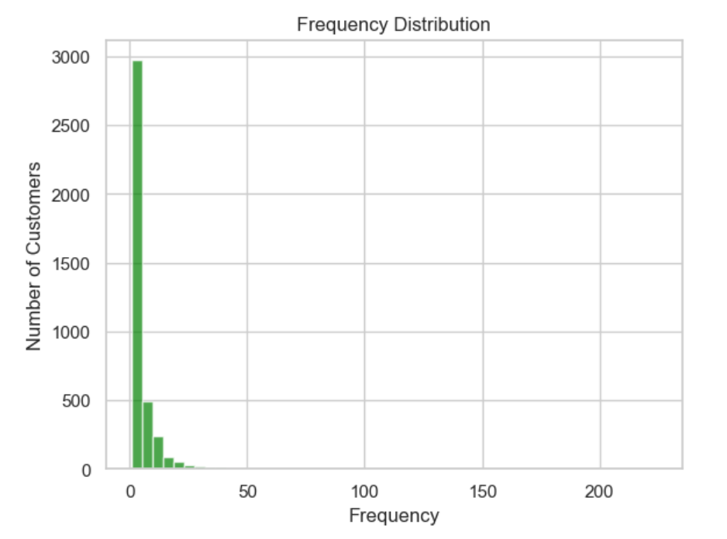
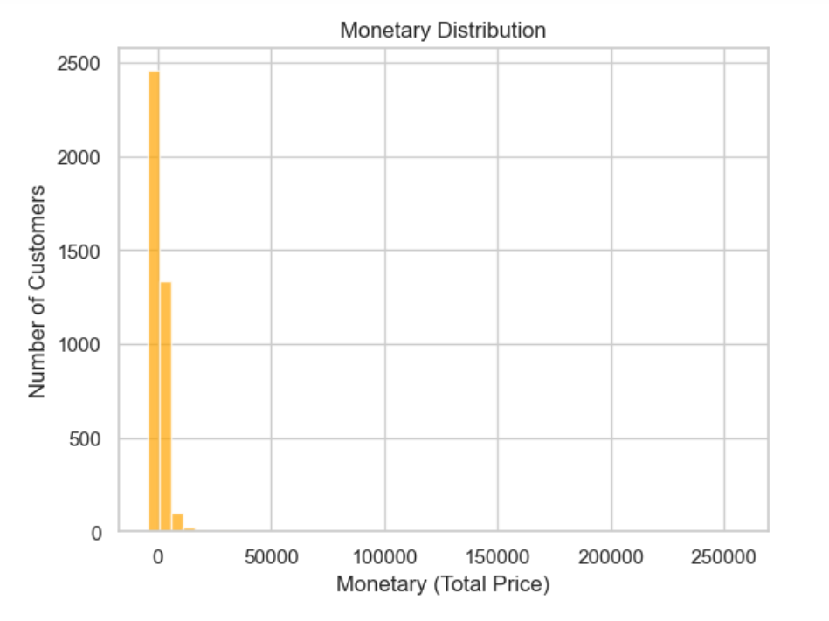
Plot RFM distributions

Slide 30
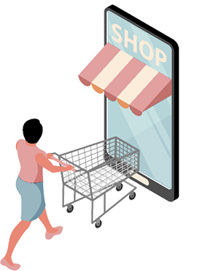
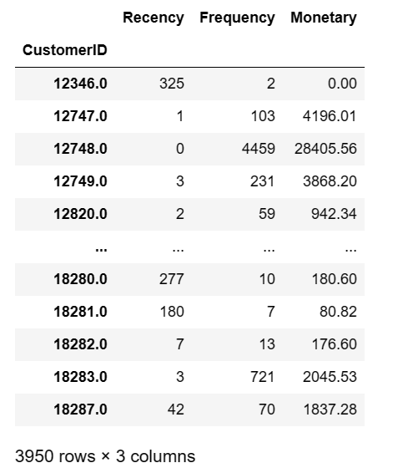
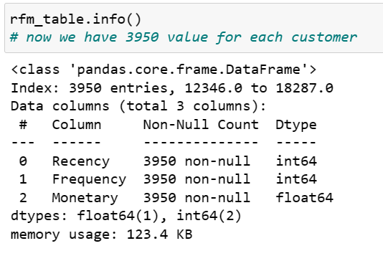
Create RFM Table

Slide 31
03
RFM Analysis
Calculate Recency, Frequency, and Monetary values for UK customers to form an RFM table.

Slide 32
04
Customer Segmentation

Slide 33
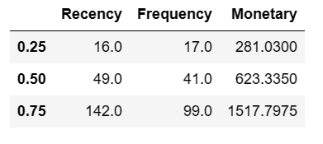
STEP to Creating the RFM Segmentation Table
Create two functions: one scores Recency, giving 4 to customers in the first quarter; the other scores Frequency and Monetary, assigning 4 to customers in the last quarter.
Score customers from 1 to 4 by applying the functions
create separate score column for each value.
Divide the df_rfm into quarters

Slide 34
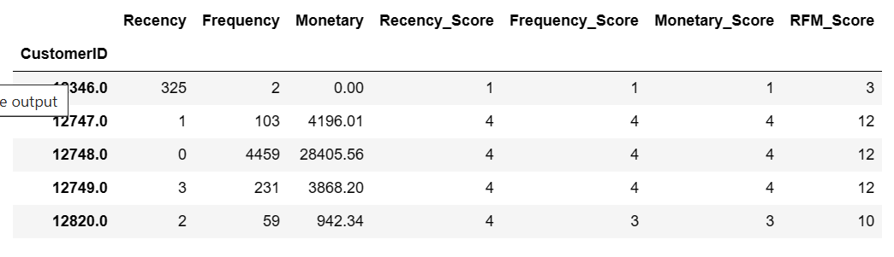
Table of the scores

Slide 35
STEP to calculate the recency values
Define rfm_level function that tags customers by using RFM_Scrores and Create a new variable RFM_Level
Now that scored each customer, you'll combine the scores for segmentation.

Slide 36
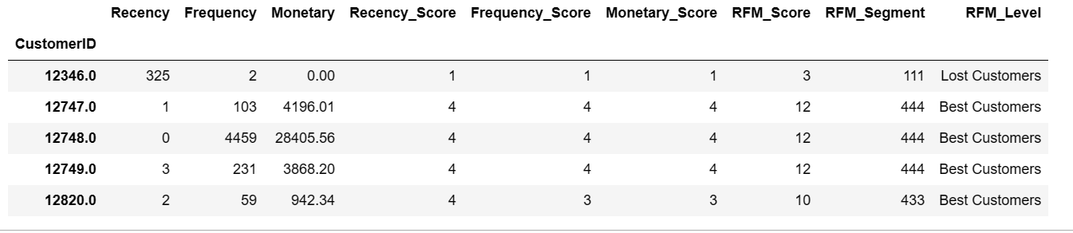
RFM Segmentation Table

Slide 37
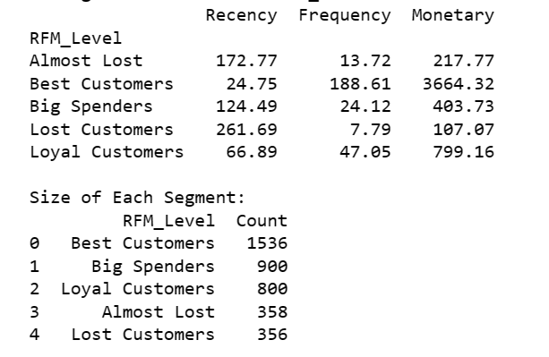
Average Values for Each RFM_Level
Notes:
# Average Values for Each RFM_Level:
# Almost Lost: Customers who are on the verge of being lost. They have an average recency of 172.77 days,
# an average frequency of 13.72 transactions, and an average monetary value of 217.77.
# Best Customers: The most valuable customers. They have an average recency of 24.75 days,
# a high average frequency of 188.61 transactions, and a substantial average monetary value of 3664.32.
# Big Spenders: Customers who spend a lot but might not be as frequent. They have an average recency of 124.49 days,
# an average frequency of 24.12 transactions, and an average monetary value of 403.73.
# Lost Customers: Customers who have been lost. They have a higher average recency of 261.69 days,
# a lower average frequency of 7.79 transactions, and a lower average monetary value of 107.07.
# Loyal Customers: Customers who are both frequent and valuable. They have an average recency of 66.89 days,
# a high average frequency of 47.05 transactions, and a substantial average monetary value of 799.16.
# Size of Each Segment:
# Best Customers: There are 1536 customers classified as "Best Customers."
# Big Spenders: There are 900 customers classified as "Big Spenders."
# Loyal Customers: There are 800 customers classified as "Loyal Customers."
# Almost Lost: There are 358 customers classified as "Almost Lost."
# Lost Customers: There are 356 customers classified as "Lost Customers."

Slide 38
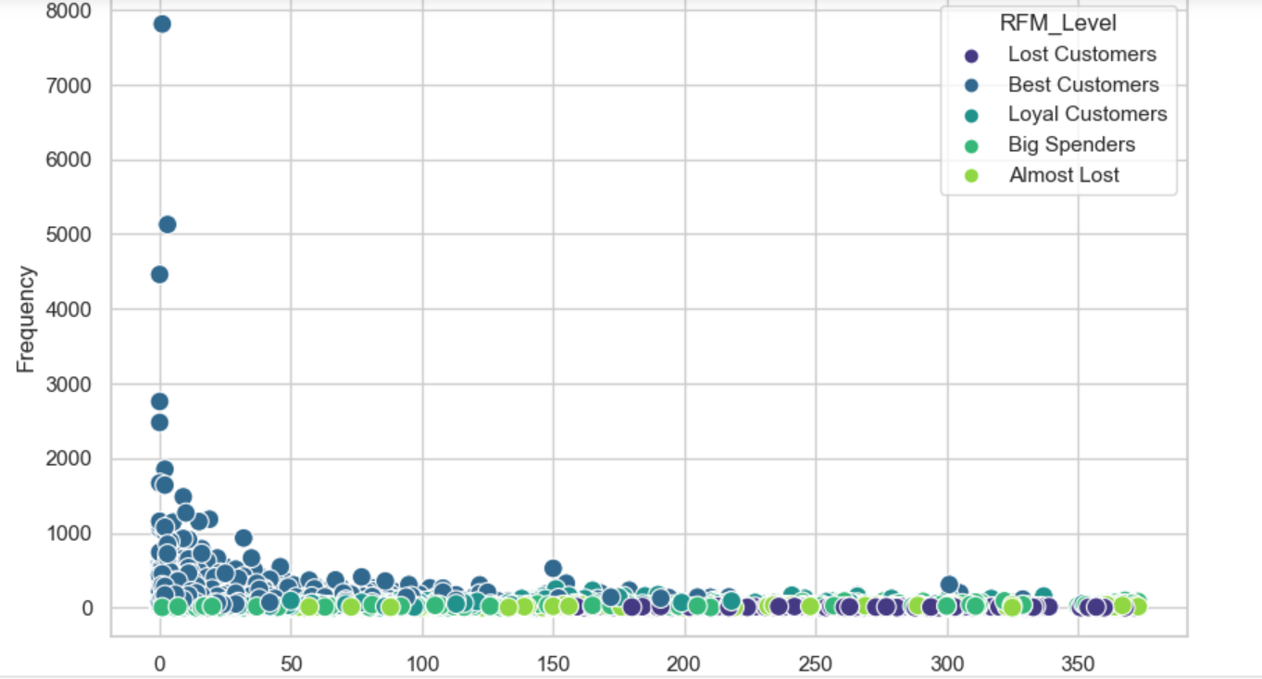
Plot RFM Segments

Slide 39
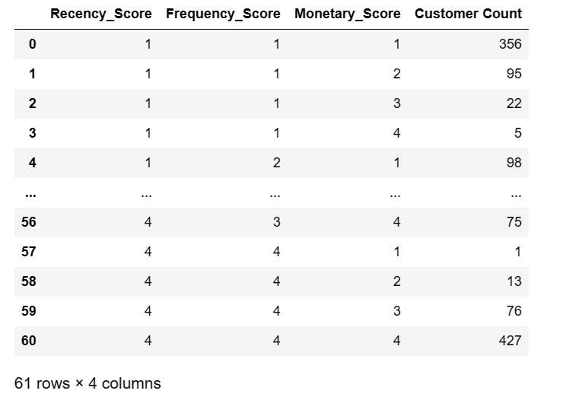
The number of customers in each RFM segment
Count the number of customers in each RFM segment
1 1 1 not recent, infrequent, low monetary
4 4 4 recent, frequent, high monetary

Slide 40
04
Customer Segmentation
Develop an RFM Segmentation Table, labeling customers into segments like "Big Spenders" and "Lost Customers."
Consider the application of unsupervised learning algorithms for automated segmentation and compare results with manual classification.

Slide 41
05
Clustering

Slide 42
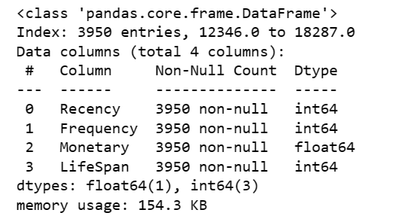
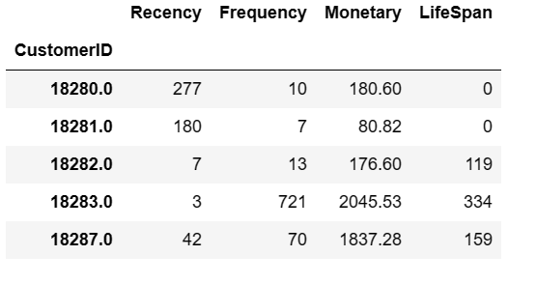
Data Pre-Processing and Exploring for Clustering

Slide 43
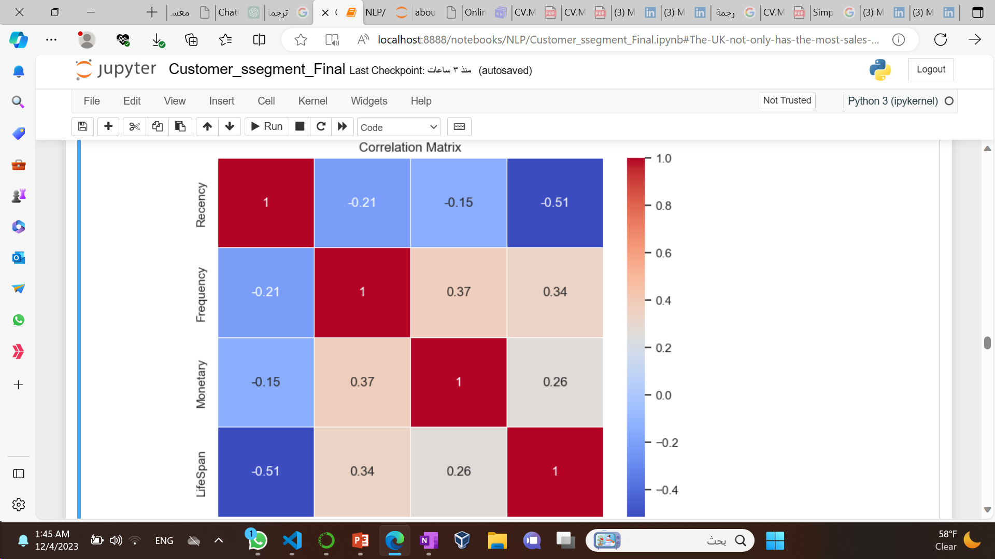
Visualize the correlation matrix as a heatmap

Slide 44
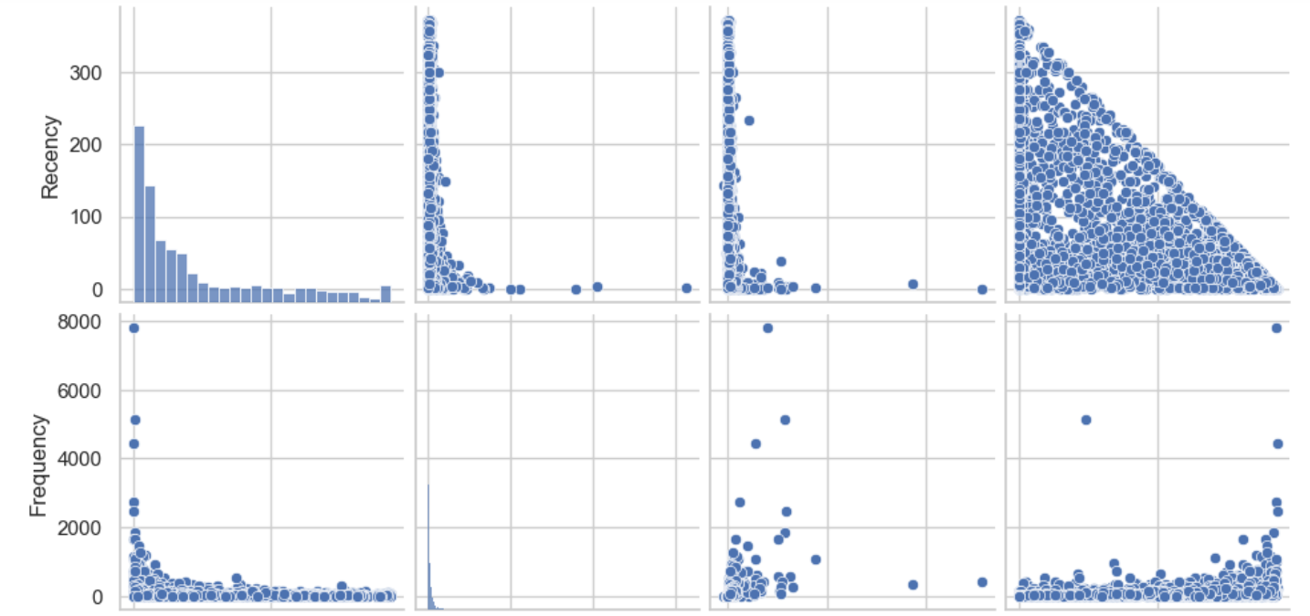
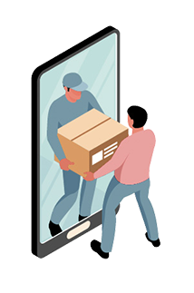
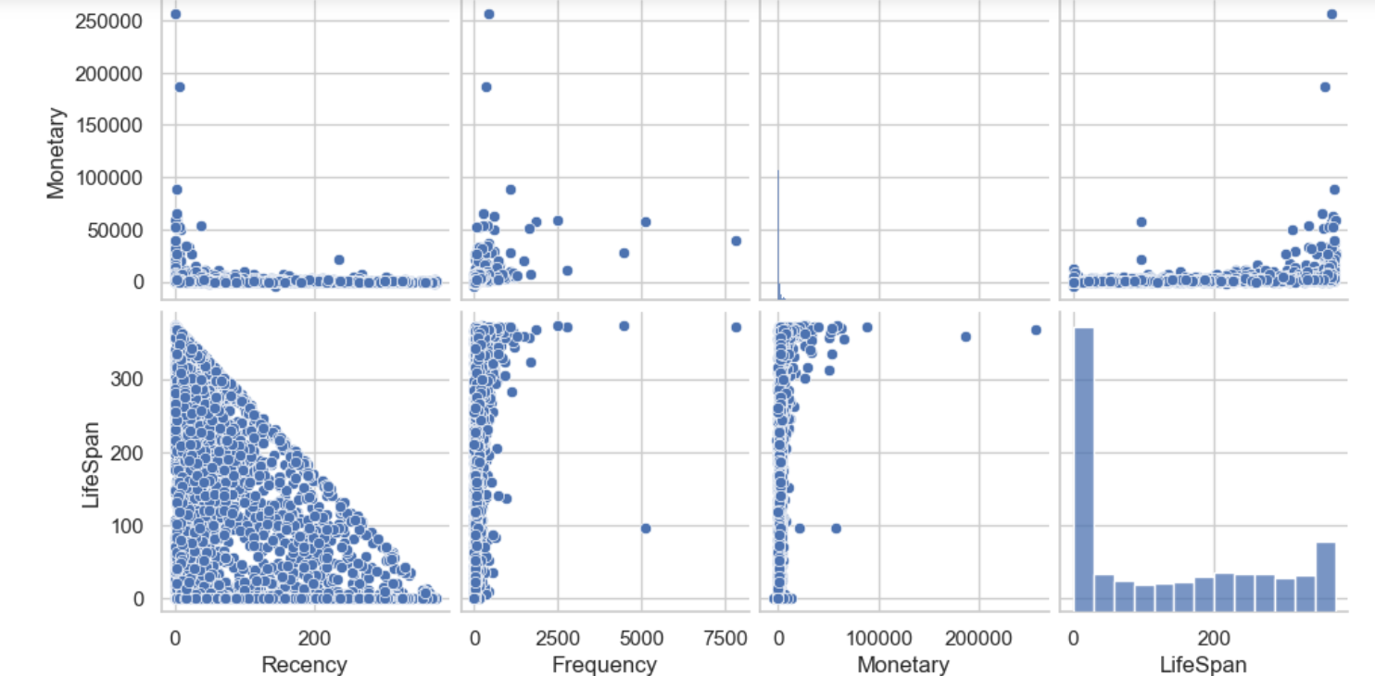
Visualize Feature Distributions

Slide 45
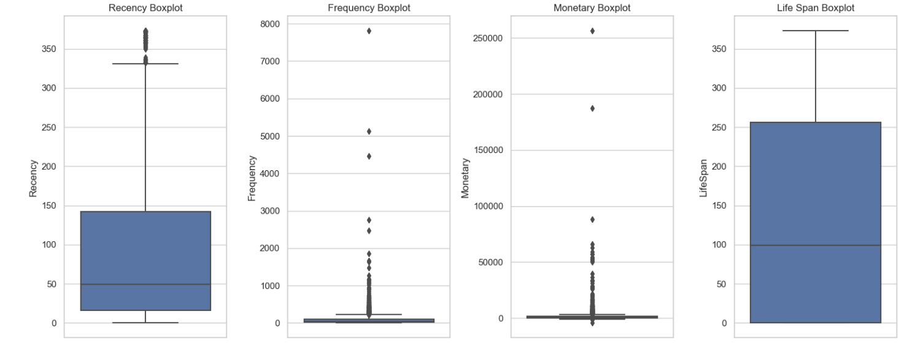
Visualize Feature Distributions

Slide 46
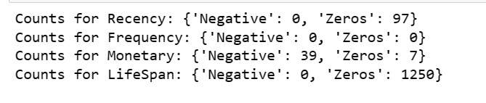
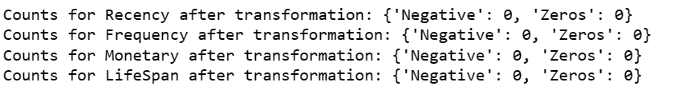
Data Normalization
Before Logarithmic Tranformation
After Logarithmic Tranformation

Slide 47
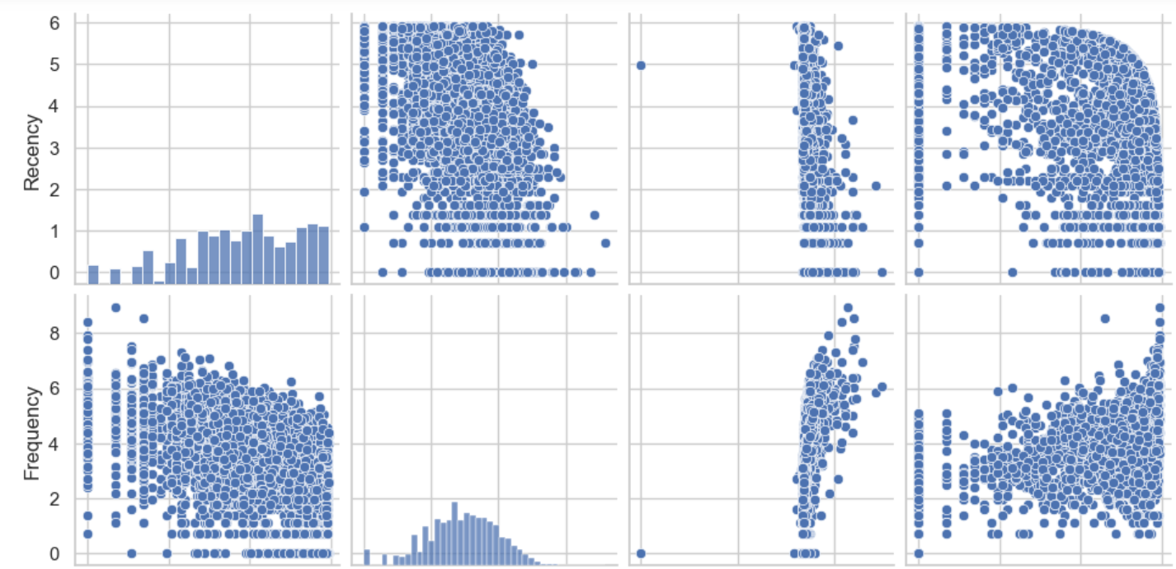
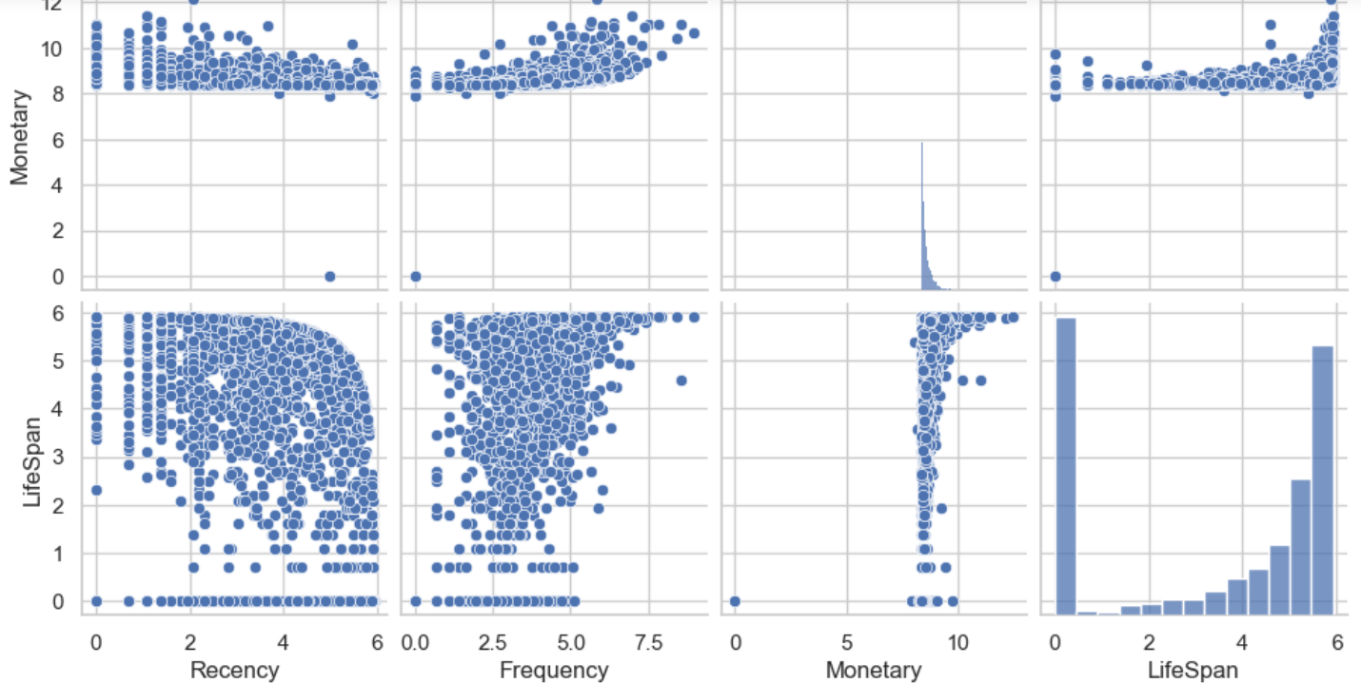
Data Normalization

Slide 48

Data Normalization

Slide 49

correlation matrix as a heatmap

Slide 50


Clustering Implementation
hopkins's statistic 0.954
our data is very good to cluster
We implement clustering using K-means Clustering
elbow method and silhouette are showing 3 as the best K

Slide 51

Visualize K-means Clustering

Slide 52

Visualize K-means Clustering

Slide 53

K-Means Clustering - Frequency vs Monetary

Slide 54

Cluster Id vs Recency, Cluster Id vs Frequency and Cluster Id vs Monetary using Box plot

Slide 55


Distribution of Clustering (compare)

Slide 56
05
Clustering
Perform data pre-processing, examining feature correlations and distributions.
Apply unsupervised clustering algorithms to estimate customer clusters.
Visualize cluster distribution through scatter plots and interpret results using boxplots.

Slide 57
06
Cohort Analysis

Slide 58


custome Invoice Month and Cohort Month
Create 1st Cohort: User number & Retention Rate
Notes:
Row 0:
CohortMonth: December 2010 (the month the cohort was formed).
CohortIndex: 0 (the first month since the cohort was formed).
Row 1:
CohortMonth: December 2010 (the same cohort as the first row).
CohortIndex: 1 (the second month since the cohort was formed).

Slide 59


heatmap for the cohort 1 retention matrix

Slide 60

Create the 2nd Cohort: Average Quantity Sold

Slide 61


heatmap for the cohort 2

Slide 62

Create the 3rd Cohort: Average Sales

Slide 63


heatmap for the cohort 3

Slide 64
06
Cohort Analysis
Conduct cohort analysis, a subset of behavioral analytics, to track metrics such as retention, churn, and lifetime value.
Analyze user data by breaking them into related groups, providing insights into customer behavior over time.

Slide 65
—conclusion
In summary, the project explored customer behavior through EDA, RFM analysis, and clustering with K-means, Agglomerative, and Gaussian Mixture. The insights gained provide actionable strategies for targeted marketing and improved customer engagement.

Slide 66

THANKS
Do you have any questions?

